Slide 1

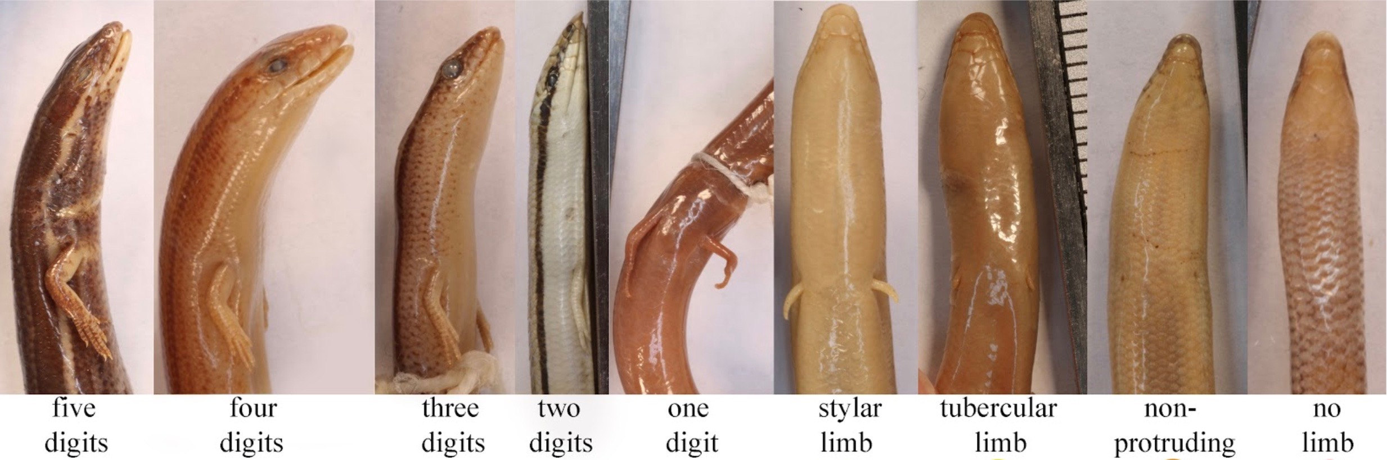
Krista Koeller
PhD student at the University of Florida
kkoeller3115@ufl.edu
@KristaLerista

Slide 2
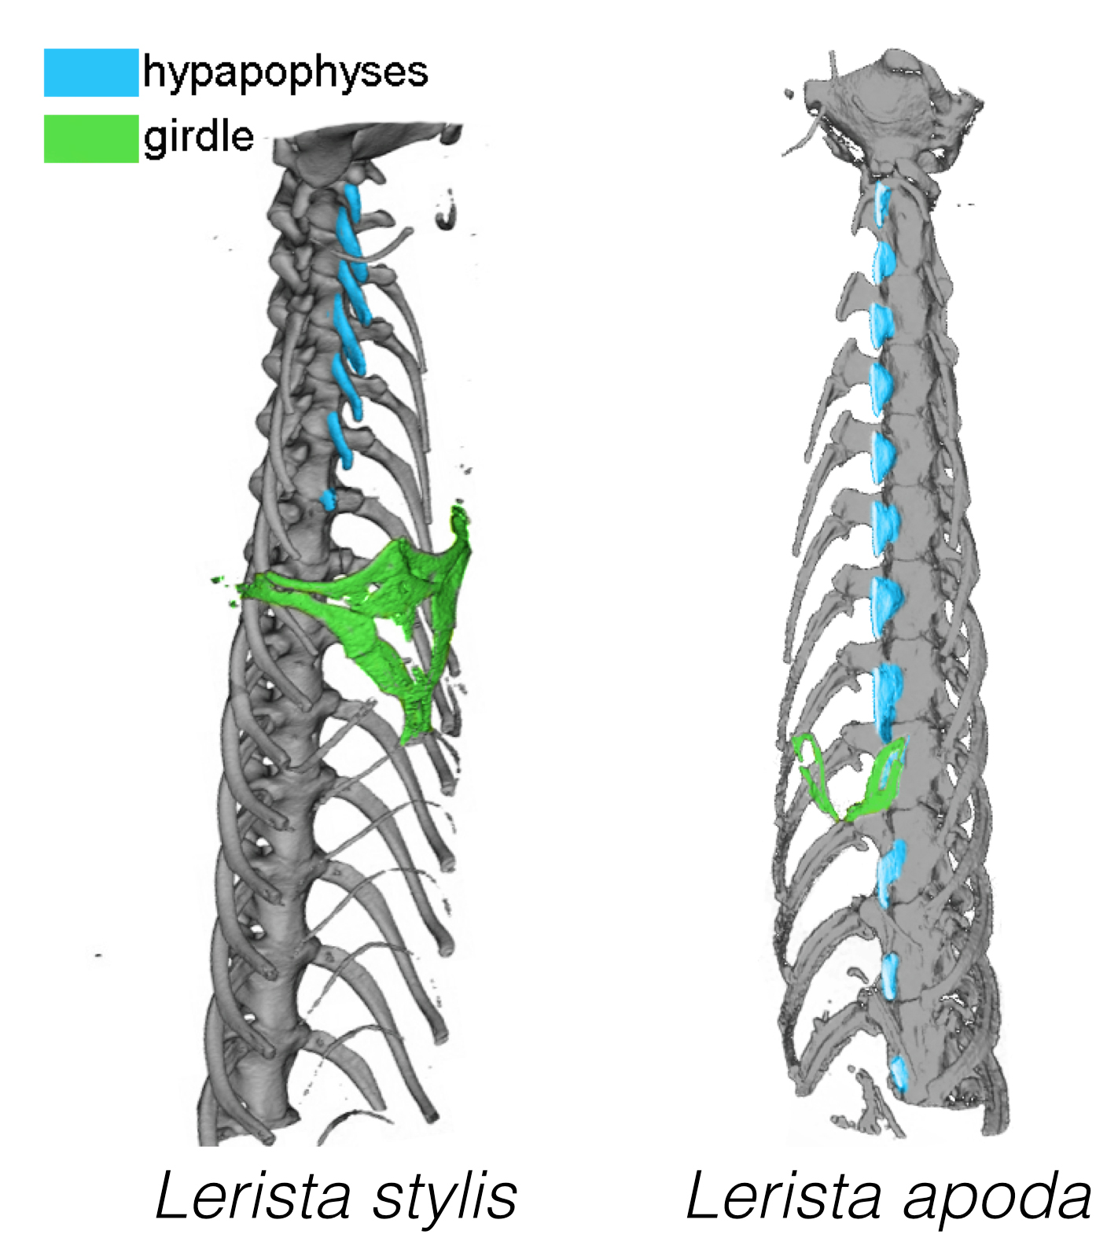
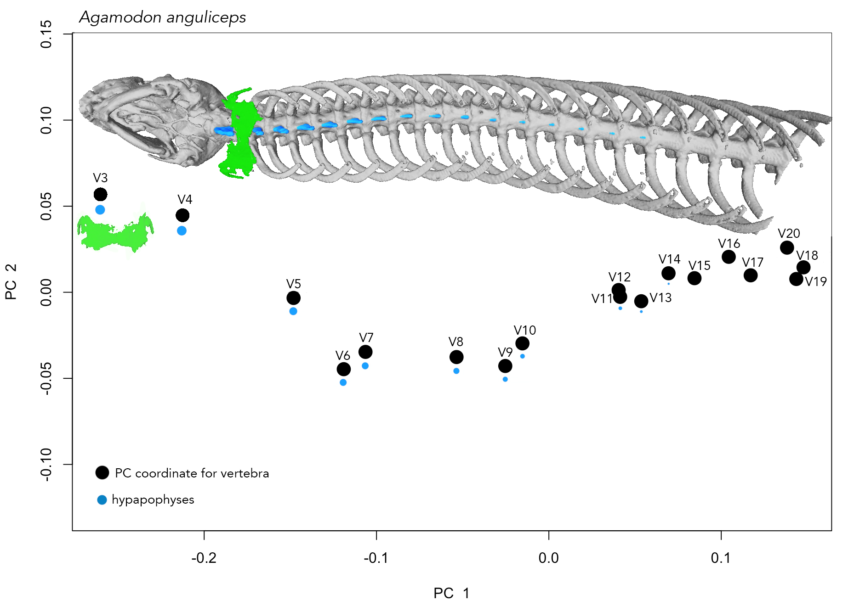
I use morphometrics to study the break down of the neck-trunk boundary
Girdle
Hypapophyses
Morphometric
Lerista edwardsae

Slide 3
Using morphometrics to study pectoral girdle evolution

Slide 4
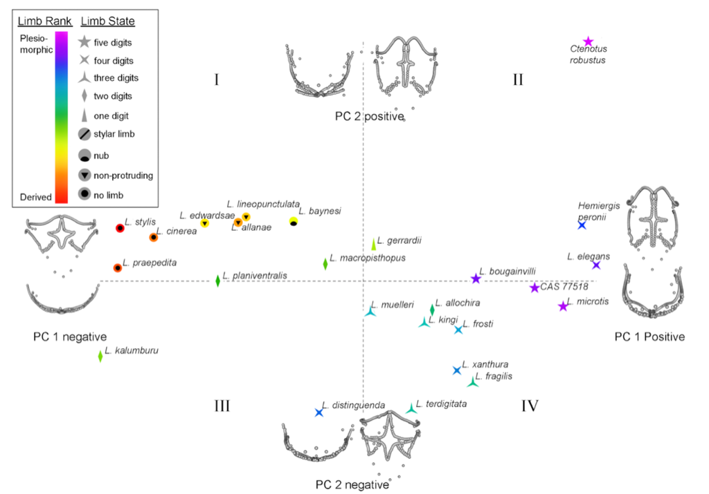
Using morphometrics to study pectoral girdle evolution
Krista Koeller
kkoeller3115@ufl.edu
@KristaLerista

Slide 5
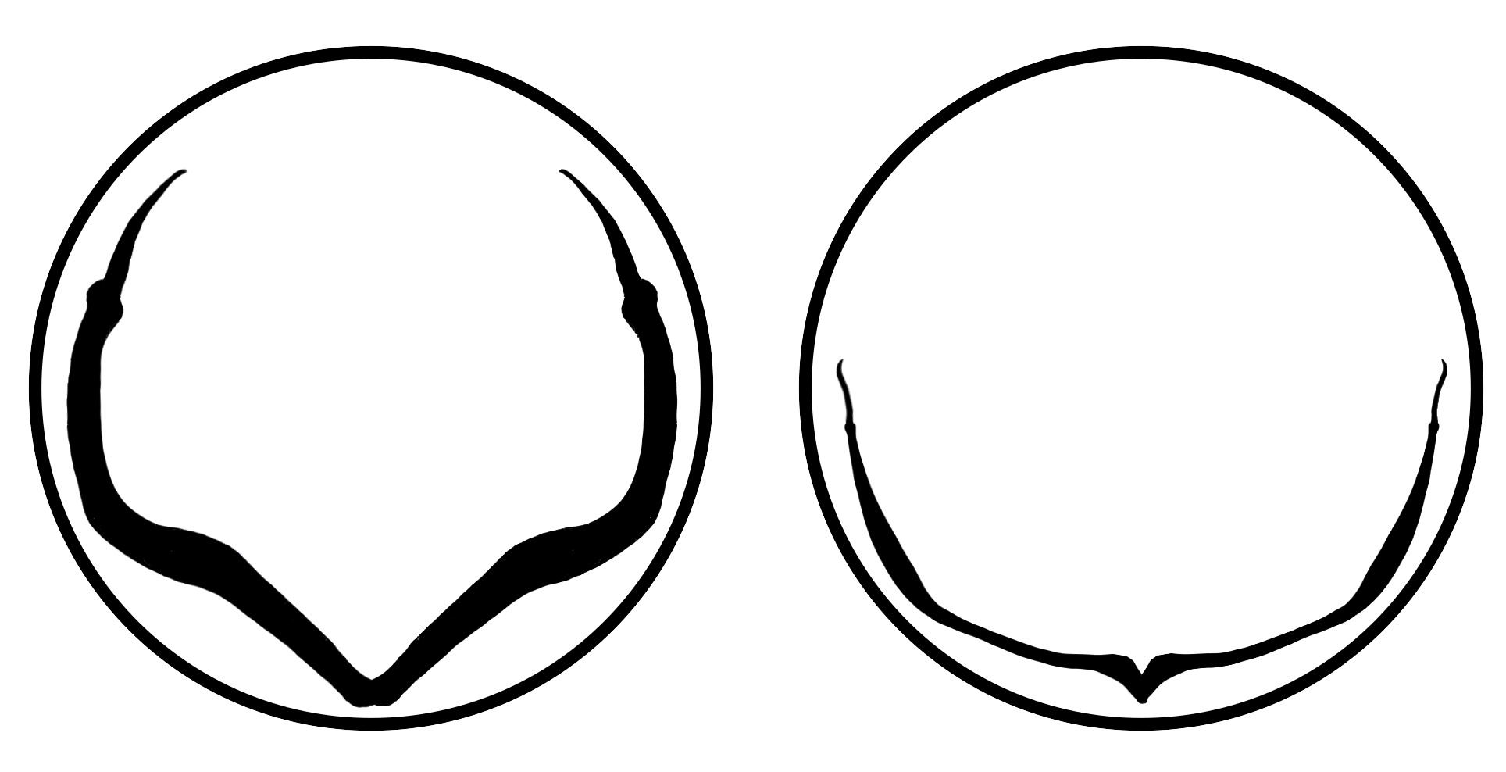
Question: How might I analyze pectoral girdles with variable curves?
Well developed girdle
Reduced girdle
Krista Koeller
kkoeller3115@ufl.edu
@KristaLerista

